Slide 1
Lab 8

Slide 2
Deque
Stack + Queue
Add/remove front; add/remove end. No insertion/deletion in the middle.
For this lab you have a slightly different variation

Slide 3
Deque.h
Private Variables
value_type** blocker_pointers; // Pointer to front of the entire chunk
value_type** blocker_pointer_end; // Pointer to end of the entire chunk
value_type** first_bp; // Pointer to front of the existing pointer
value_type** last_bp; // Pointer to end of the existing pointer
value_type* front_ptr; // Pointer to front of the existing data
value_type* back_ptr; // Pointer to end of the existing data
size_type bp_array_size; // Capacity for the chunks
size_type block_size; // Capacity of each block

Slide 4
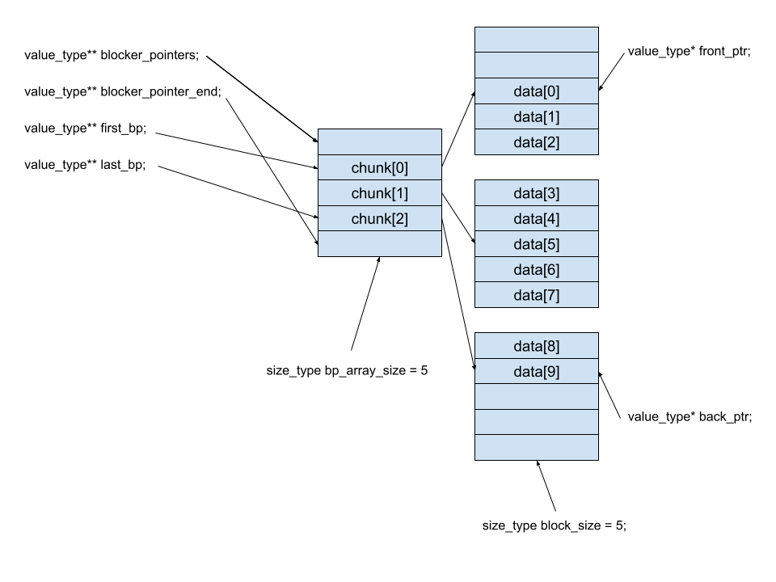

Slide 5
Deque_iterator.h
Iterates Through the Deque
Private Variables
value_type* cursor; // Pointer to the data
value_type** current_block_pointer; // Pointer to the chunk
value_type* current_boundary; // Pointer to the very end of the last block

Slide 6
Deque Main
Test 1: constructor test
Initialize deque<int> called myDeque1
Test 2: push_back() and back()
push_back() 1,2,...,99,100 into myDeque1
Cout mydeque1.back()
Test 3: push_front() and front()
push_front() 1,2,...,99,100 into myDeque1
Cout mydeque1.front()
Test 4: iterator
Cout values of myDeque1 from begin() to end() by using deque<int>::iterator
Test 5: pop_front()
Call pop_front() 100 times
Call front() and end() to get the first/last value

Slide 7
Deque Main
Test 6: pop_back()
Call pop_back() 10 times
Call front() and end() to get the first/last value
Test 7: iterator
Cout values of myDeque1 from begin() to end() by using deque<int>::iterator
Test 8: assignment operator
Initialize deque<int> myDeque2. push_front() 3,2,1. push_back() 4,5,6.
Initialize deque<int> myDeque3. Let myDeque3 = myDeque2.
Cout values of myDeque3 from begin() to end() by using deque<int>::iterator
Test 9: copy constructor
coen79_lab8::deque<int> myDeque4(myDeque3);
Cout values of myDeque4 from begin() to end() by using deque<int>::iterator

Slide 8
Deque Main
Test 10: Iterator test
deque<int>::iterator it_start = myDeque4.begin();
deque<int>::iterator it_end = myDeque4.end();
deque<int>::iterator it2 = it_start;
while(it2 != it_end)
{
*it2 = 950;
++it2;
}
it2 = it_start;
while(it2 != it_end)
{
std::cout << *it2 << " ";
it2++;
}

Slide 9
Hints
Reserve() adds slots for the deque
push()
Read the comments
Implement deque.h first, then deque_iterator.h
push() and pop()

Slide 10
Provided Files
deque.h
deque_iterator.h
Write your implementations in the .h file
Style recommendation (not required for lab)
When you have to write implementation details inside .h files (i.e. templates), add “_impl” suffix.

Slide 11
Don’t Forget
Demo code to me
Today or next week
Usually I will NOT be available on weekends -- plan accordingly.
Must compile and run on linux servers
Submit your code before deadline
Comment code
File with description of lab is on Camino
Submission guidelines

